Slide 1

Internship on Machine Learning Using Python
A brief description
Submitted By:
Aashique karn

Slide 2

Karunadu Technologies Private Limited #17,ATK complex,4th Floor, Acharya college main road, Beside Karur Vysya bank,Guttebasaveshwaranagar Chikkabanvara, Karnataka 560090
Services of Karunadu Technologies Private Limited:
IT Solutions and Services,
Embedded Solutions and Services,
Skill Development,
Job Consulting and Outsourcing,
Workshops in Leading Technologies,
Internships.

Slide 3
About Myself: Who Am I?
I am Aashique Karn.
I am a student of Sambhram Institute of Technology.
I am pursuing engineering in computer science stream from this college.
This is my 4th year.
Right Now I am doing internship in Karunadu Technologies Private Limited .
I am doing internship on Machine Learning Along with Python.
The project that I am assigned with is Boston Housing.
This whole presentation will be on these internship topics.

Slide 4
Python
Python is a high level, interpreted, interactive and object oriented scripting language.
It is one of the most advance 3rd generation language.
Python is Interpreted. Python is processed at runtime by interpreter.
Python is Interactive. We can interact with interpreter directly from python prompt to write out program.
Python is Object-Oriented. Python supports Object-Oriented style or technique of programming that encapsulates code within objects.
Python is Beginner’s language. Python is a fantastic language for the beginners in programming as it have a very simple syntax and programming style.

Slide 5
Advantages of Python
Easy to learn − Python has few keywords, simple structure, and a clearly defined syntax.
Easy to read − Python code is more clearly defined and visible to the eyes.
Easy to maintain − Python's source code is fairly easy-to-maintain.
A broad standard library − Python's bulk of the library is very portable and cross-platform compatible on UNIX, Windows, and Macintosh.
Databases − Python provides interfaces to all major commercial databases.
GUI Programming − Python supports GUI applications that can be created and ported to many system calls, libraries and windows systems.
It can be easily integrated with C, C++, COM, ActiveX, CORBA, and Java.

Slide 6
Disadvantages of Python
Speed. Python is slower than C or C++. And Python is not very close to hardware.
Mobile Development. Python is not very good for mobile development. It is very weak language for mobile computing.
Memory Consumption. Python is not very good choice for memory intensive tasks. Due to the flexibility of data-types, Python’s memory consumption is also high.
Runtime Errors. Since the language is dynamically typed, python requires more testing and has errors that only show up at runtime.

Slide 7
IDE’s for Python
IDLE(Integrated Devolvement and Learning Environment).
PyCharm.
Spyder.
Visual Studio.

Slide 8


Modes of Python Programming
Python programming can be done in two modes:
Interactive mode:
It can be done by invoking interpreter and directly giving commands on python prompt rather than passing a scripting file. Like
E.g.

Slide 9


Modes of Python Programming
Scripting mode: In this mode we need to write the python program in a file. The file should have an extension named .py. When we invoking the interpreter with a script parameter,it begins execution of the script and continues until the script is finished.
Let us consider we have a file named test.py, having the content as
Now to get output we need to write command on command prompt as $python test.py
It will give the output as

Slide 10

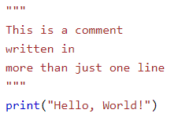
Comments in Python
In python comments can be given by two ways:
By using # (hash) symbol.
E.g.
By using three double quotes as (“”” “””). E.g.

Slide 11
Data types in Python
There are various data types in python. Some of the important data types are given below:
Numbers
Lists
Tuples
Strings
Set
Dictionary.

Slide 12



Numbers
In Python, Numbers can be of any type. They can be integer or floating points or complex numbers, etc.
Examples of integers.
Examples of floating points.
Examples of complex numbers.

Slide 13



Lists
List is an ordered sequence of items. It is one of the most used datatype in Python and is very flexible. All the items in a list do not need to be of the same type.
Creation of list.
Lists are mutable. It means that its elements can be changed after its creation. E.g.
Slicing can be performed on list. E.g

Slide 14



List Operations
Indexing in list. It can be done through negative indexing and positive indexing.
Example for positive indexing.
Example for negative indexing.
Adding two lists.

Slide 15

Tuples
Tuples is an ordered sequence of items same as list. The only difference is that tuples are immutable. Tuples once created cannot be modified.
It is defined within parentheses () where items are separated by commas. E.g.
Most of the operations can be performed in tuples those can be performed in lists. But since, list is mutable and tuples is immutable. But changing its member elements can’t be possible.

Slide 16
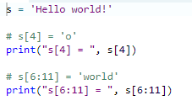
Strings
String is a sequence of Unicode characters. It can be donated using single quotes(‘ ‘), double quotes(‘’ ‘’).
E.g.
Performing some operations on strings.

Slide 17
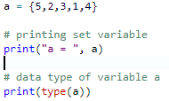
Sets
Set is an unordered collection of unique items. Set is defined by values separated by comma inside braces { }. Items in a set are not ordered.
E.g.
We can perform set operations like union, intersection on two sets. Set have unique values. They eliminate duplicates.

Slide 18

Dictionary
Dictionary is an unordered collection of key-value pairs.
It is generally used when we have a huge amount of data. Dictionaries are optimized for retrieving data. We must know the key to retrieve the value.
In Python, dictionaries are defined within braces {} with each item being a pair in the form key : value. Key and value can be of any type.
E.g.

Slide 19
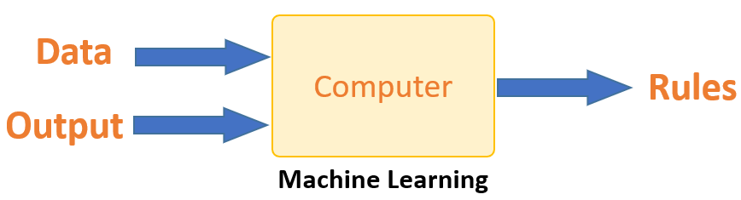
Introduction to Machine Learning
Machine Learning is a system that can learn from example through self-improvement and without being explicitly coded by programmer. The breakthrough comes with the idea that a machine can singularly learn from the data (i.e., example) to produce accurate results.
The machine learns how the input and output data are correlated and it writes a rule. The programmers do not need to write new rules each time there is new data.

Slide 20
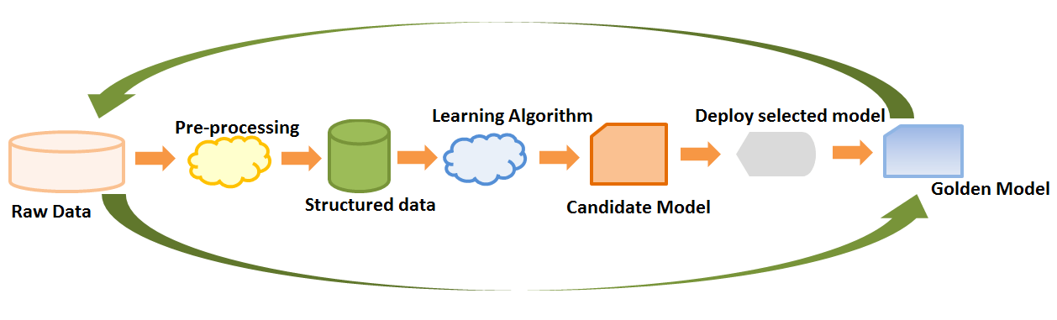
How Machine Learning Works?
The Machine Learning have the following process:
Raw Data: It contains the raw data input for the learning process.
Pre-Processing: This is a technique for converting the raw dataset into cleaned dataset.

Slide 21
How Machine Learning Works?
Structured Data: Structured data is comprised of clearly defined data types whose pattern makes them easily searchable. Structured data usually resides in relational databases (RDBMS).
Learning Algorithms: Some of Learning Algorithm for machine learning are linear regression, logistic regression, induction tree, SVM, Naïve Bayes, KNN, etc.
Candidate Model: Candidate model is a model that approximates a target function for mapping inputs to outputs.
Golden Model: This is the model which is finally approved for performing machine learning works.

Slide 22
Applications of Machine Learning
Applications of Machine learning are:
Virtual Personal Assistant: Google Assistance, Cortana, Azure, etc.
Social media Service: Face Recognition, People you may know, etc.
Email Spam and Malware Filtering: Gmail ,etc.
Search Engine Result Filtering: Google, Bingo, Baidu, etc.

Slide 23
Types of Machine Learning
There are several types of Machine Learning. Some of the important types are:
Supervised Machine Learning
Unsupervised Machine Learning
Reinforcement Machine Learning
Semi Supervised Machine Learning
Among these above two are discussed here.

Slide 24
Supervised Machine Learning
Supervised learning algorithms are used when the output is classified or labelled. These algorithms learn from the past data that is inputted, called as training data, runs its analysis and uses this analysis to predict future events of any new data within the known classifications
Examples of Supervised Machine Learnings are:
Image Classification – The algorithm is drawn from feeding with labelled image data. An algorithm is trained and it is expected that in the case of the new image the algorithm classifies it correctly.
Market Prediction – It is also called Regression. Historical business market data is fed to the computer. With analysis and regression algorithm new price for the future is predicted depending on variables.

Slide 25
Unsupervised Machine Learning
Unsupervised learning algorithms are used when we are unaware of the final outputs and the classification or labelled outputs are not at our disposal.
Examples of Unsupervised Machine Learnings are:
Clustering – Data with similar traits are asked to group together by the algorithm, this grouping is called clusters. These prove helpful in the study of these groups which can be applied on the entire data within a cluster more or less.
High Dimension Data – High dimension data is normally not easy to work with. With the help of unsupervised learning, visualization of high dimension data becomes possible

Slide 26
Machine Learning Algorithm
There are various types of machine learning algorithms. Some of them are:
Linear Regression
Polynomial Regression
Multinomial Regression
Logistic Regression
K Means
K-Nearest Neighborhood(KNN)

Slide 27
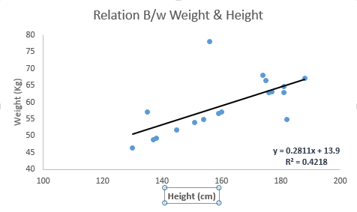
Linear Regression
Linear Regression establishes a relationship between dependent variable (Y) and one or more independent variables (X) using a best fit straight line (also known as regression line).
It is represented by an equation Y=a+b*X + e, where a is intercept, b is slope of the line and e is error term.

Slide 28
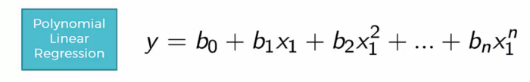
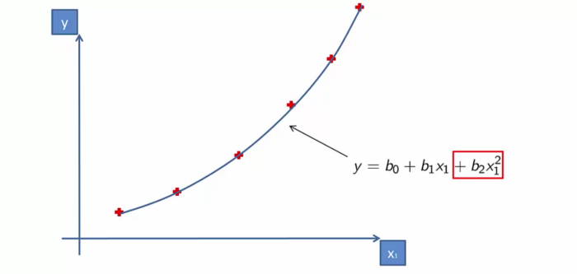
Polynomial Regression
Polynomial regression is a form of regression analysis in which the relationship between the independent variable x and the dependent variable y is modelled as an nth degree polynomial in x.
Polynomial regression is given by formula:
It can be shown in graph as:

Slide 29
Multiple Regression
In many cases, there may be possibilities of dealing with more than one predictor variable for finding out the value of the response variable.
Using the two explanatory variables, we can delineate the equation of multiple linear regression as follows:
yi = β0 + β1x1i + β2x1i + εi Here The two explanatory variables x1i and x1i, determine yi, for the ith data point. Furthermore, the predictor variables are also determined by the three parameters β0, β1, and β2 of the model, and by the residual ε1 of the point i from the fitted surface.
General Multiple regression models can be represented as:
yi = Σβ1x1i + εi

Slide 30
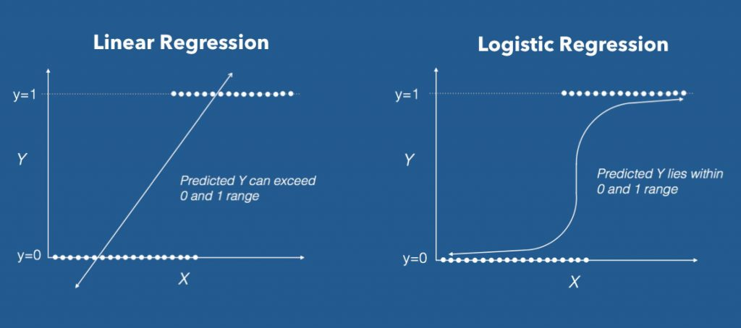
Logistic Regression
Logistic regression is a statistical model that in its basic form uses a logistic function to model a binary dependent variable, although many more complex extensions exist.
Logistic regression predicts whether something is True(1) or False(0) instead, predicting something that is continuous like size.
It has an S-shaped line.

Slide 31
K Means Algorithm
K-means (Macqueen, 1967) is one of the simplest unsupervised learning algorithms that solve the well-known clustering problem. K-means clustering is a method of vector quantization, originally from signal processing, that is popular for cluster analysis in data mining.
K- Means Clustering Algorithm needs the following inputs:
K = number of subgroups or clusters
Sample or Training Set = {x₁, x₂, x₃,………x_{n}}
Now let us assume we have a data set which is unlabeled and we need to divide it into clusters.

Slide 32
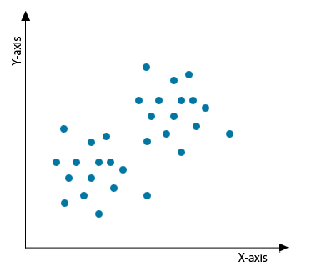
How K Means Algorithm Works?
We can find the number of clusters by two methods. They are:
Elbow method(We are going to discuss)
Purpose Method
Elbow Method-In this method, a curve is drawn between “within the sum of squares” (WSS) and the number of clusters. The curve plotted resembles a human arm. It is called the elbow method because the point of elbow in the curve gives us the optimum number of clusters.,

Slide 33
K-Nearest Neighborhood Algorithms
K nearest neighbors or KNN Algorithm is a simple algorithm which uses the entire dataset in its training phase.
KNN is a Supervised Learning algorithm that uses labeled input data set to predict the output of the data points.
It is mainly based on feature similarity. KNN checks how similar a data point is to its neighbor and classifies the data point into the class it is most similar to.

Slide 34
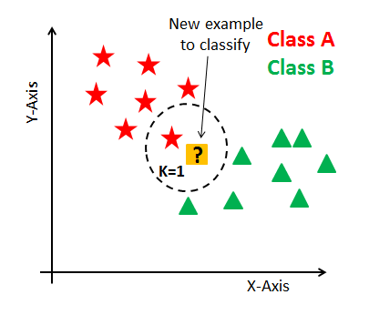
How KNN Works?
In KNN, K is the number of nearest neighbors. The number of neighbors is the core deciding factor. K is generally an odd number if the number of classes is 2. When K=1, then the algorithm is known as the nearest neighbor algorithm.
KNN has the following basic steps:
Calculate distance
Find closest neighbors
Vote for labels

Slide 35
My Project: Aim
The purpose of my project is to build a model which can predict the prices of houses of Boston.
I need to train that model and test it using some data given.
The algorithm used to build this model is Linear Regression.
A csv file is provided for doing this project.

Slide 36
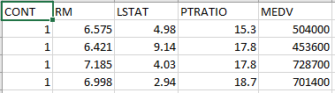
My Project : Dataset
A file named housing.csv is given containing data. The Boston data frame has 506 rows and 14 columns. A small sample of it can be shown as:
In the above table:
RM means average number of rooms per dwelling.
LSTAT means lower status of the population (percent).
PTRATIO means pupil-teacher ratio by town.
MEDV median value of owner-occupied homes in \$1000s.. And this is the target variable.

Slide 37
My Project: Linear Regression Algorithm
In this algorithm, firstly we need to choose target variable and independent variable.
Target variable is MEDV which is median value of owner-occupied homes in \$1000s.
There is a conflict in independent variable. i.e. which one is independent variable.
It can be RM or LSTAT or PTRATIO.
So the Linear Regression should be performed on all these three variables.

Slide 38
My Project: Python Library Required
There are three library needed to perform this task. These are:
NumPy: It is a library for the Python programming language, adding support for large, multi-dimensional arrays and matrices, along with a large collection of high-level mathematical functions to operate on these arrays.
Matplotlib: It is a plotting library for the Python programming language and its numerical mathematics extension NumPy. It provides an object-oriented API for embedding plots into applications using general-purpose GUI toolkits like Tkinter, wxPython, Qt, or GTK+
Pandas: In computer programming, pandas is a software library written for the Python programming language for data manipulation and analysis. In particular, it offers data structures and operations for manipulating numerical tables and time series.

Slide 39


MyProject : Programming Codes
Importing Libraries:
Extracting data from column:
Rest of the codes are in project.

Slide 40
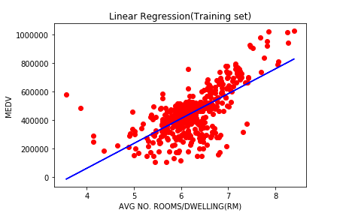
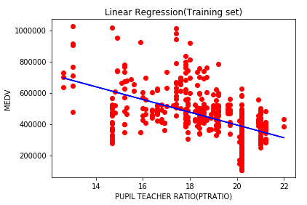
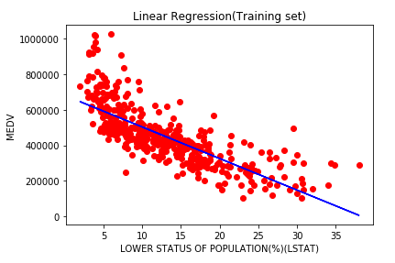
MyProject : Outputs(Training Sets)

Slide 41
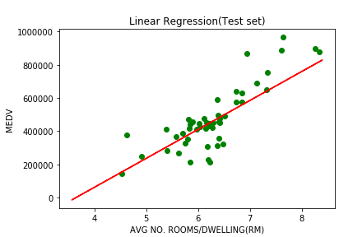
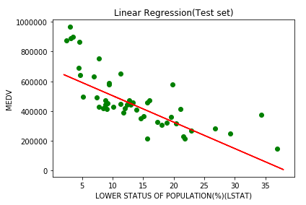
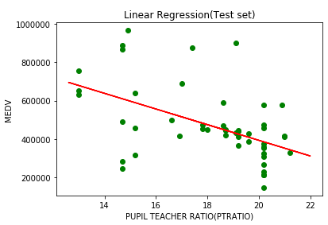
MyProject : Outputs(Testing sets)

Slide 42
MyProject : Conclusion
After doing this project we come to the following conclusion:
We came to know about Linear Regression from up-close.
We learnt how to implement Linear Regression via coding in python.
Linear Regression is the perfect algorithm for predicting the prices of houses in Boston.

